Slide 1

Food Sales Predictions
Tijesunimi Odebode

Slide 2
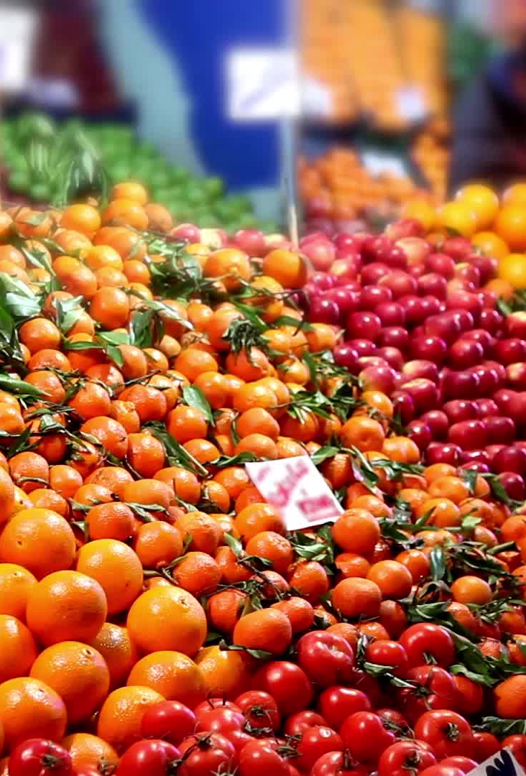
Business Problem
Walmart is trying to improve the sales of their food products. In order to improve sales, they are interested in knowing which of the following categories of foods has sold more in the past: Low Fat Foods or Regular Fat Foods. With this information, they can decide to increase the stock of that category of food with the goal of improving their overall sales of food products. Walmart also wants to know if the visibility of the category of food with more sales correlates with its sales in the past. ‘Visibility’ refers to the percentage of total display area of all products in a store allocated to the particular product.

Slide 3
Methods
Import data set that contains the properties of food products and outlets that play crucial roles in increasing sales
Compare the average sales of “Low Fat” and “Regular Fat” food products in various stores
Determine if there is any correlation between food product visibility and sales of food product

Slide 4
Data
Data Source: https://datahack.analyticsvidhya.com/contest/practice-problem-big-mart-sales-iii/
Data contains 12 columns and 8523 rows
The food products are either from a supermarket or grocery store
The following are the types of foods included in this study: fruits and vegetables, snack foods, household, frozen foods, dairy, canned, baking goods, health and hygiene, soft drinks, meat, breads, hard drinks, starchy foods, breakfast, seafood and others.

Slide 5
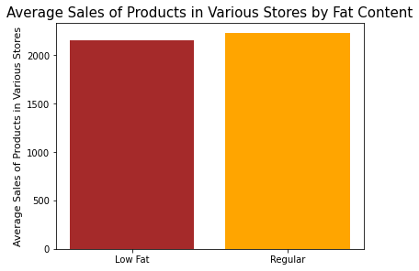
Question 1: Which food product has higher sales: “Low Fat” or “Regular”
The average sales of products in various stores is higher for food products with Regular Fat content than food products with Low Fat content.

Slide 6
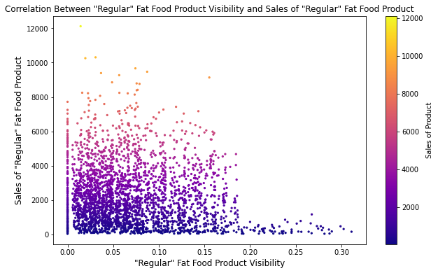
Question 2: Does visibility of “Regular Fat” foods correlate with sales?
There seems to be no correlation between product visibility (the percentage of total display area of all products in a store allocated to the particular product) and sales of product in the particular store.

Slide 7
Conclusion
To improve sales of food products, Walmart would have to increase the quantity of foods with Regular fat that they sell.
In addition, based on previous data, there is no correlation between visibility and sales of “Regular Fat” food products. As a result, it does not matter how large the display area allocated to the “Regular Fat” product is.

Slide 8
Thank You!
Email: tijesunimi@yahoo.com
LinkedIn: www.linkedin.com/in/tijesunimi-odebode-ms-phd
Github: https://github.com/todebode

